Slide 1
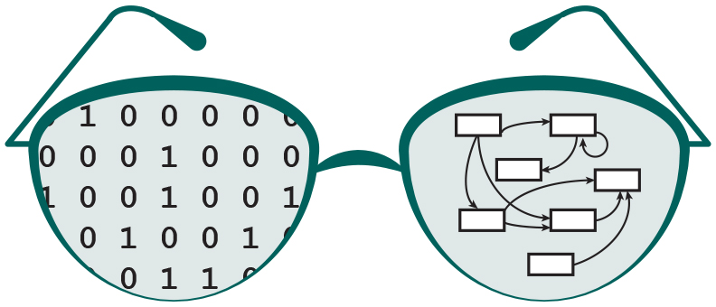
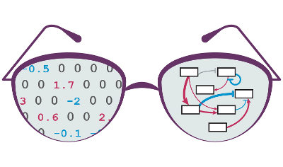

Design and Layout Improvement to GRNsight v2.0: a Web Application and Service for Visualizing Small- to Medium-Scale Gene Regulatory Networks
Anindita Varshneya and Nicole Anguiano
Department of Biology
Department of Electrical Engineering and Computer Science
Loyola Marymount University
LMU Undergraduate Research Symposium
March 25, 2017
Notes:
anu

Slide 2
Outline
Gene regulatory networks (GRNs) consist of genes, transcription factors, and the regulatory relationships between them.
GRNsight is an open source web application and service for visualizing models of gene regulatory networks.
Version 1.0 established a testing framework and created an errors and warnings library.
Version 2.0 is in active development, available in beta website, and will allow for greater customization of the graph visuals.
Notes:
anu

Slide 3
Outline
Gene regulatory networks (GRNs) consist of genes, transcription factors, and the regulatory relationships between them.
GRNsight is an open source web application and service for visualizing models of gene regulatory networks.
Version 1.0 established a testing framework and created an errors and warnings library.
Version 2.0 is in active development, available in beta website, and will allow for greater customization of the graph visuals.
Notes:
anu

Slide 4
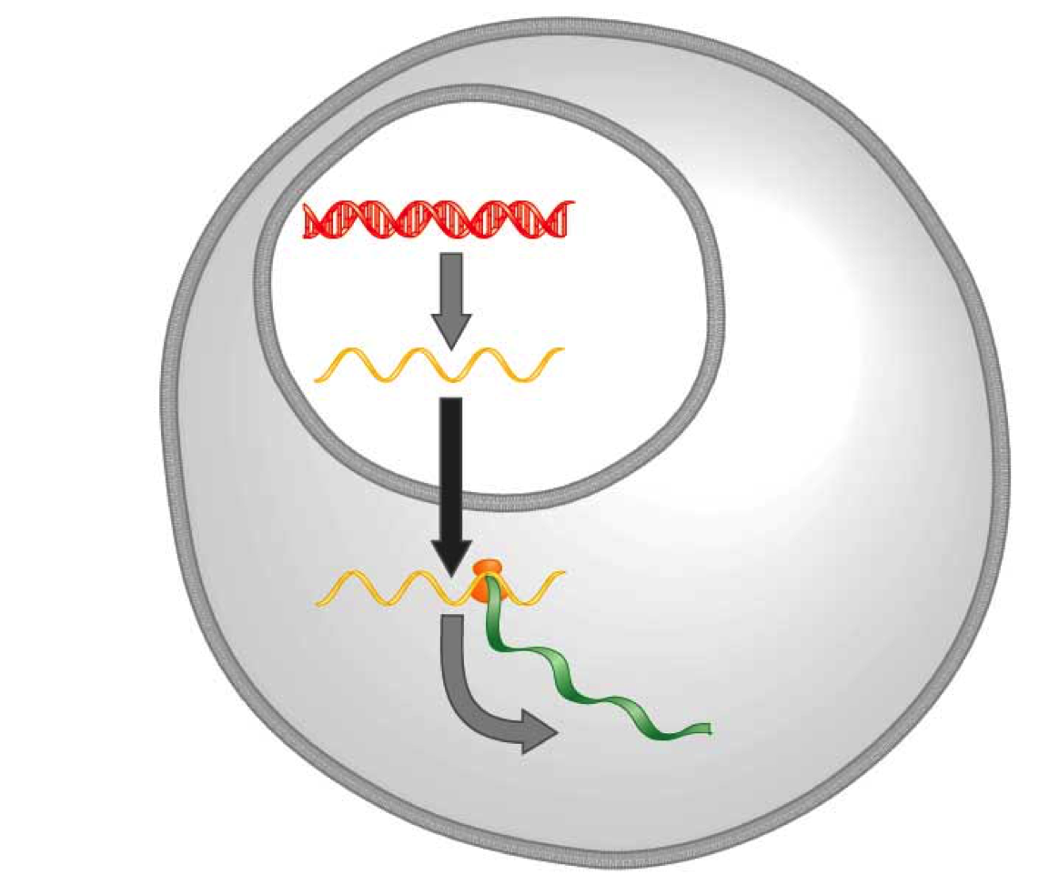
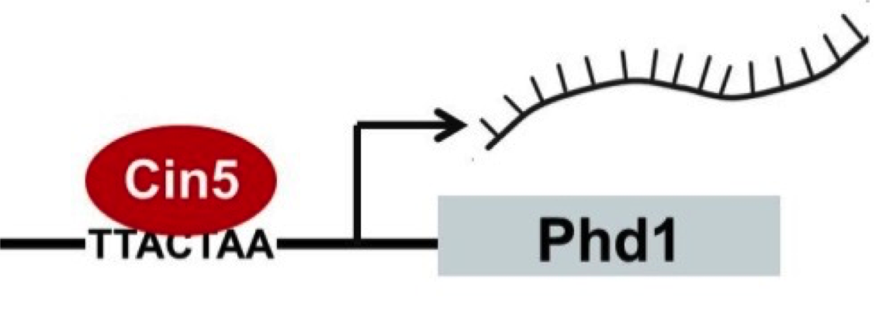
Transcription Factors Control Gene Expression By Binding to Regulatory DNA Sequences
Activators increase gene expression
Repressors decrease gene expression
Gene regulatory networks govern the level of expression of mRNA and proteins from those genes.
DNA
Transcription
mRNA
Translation
Protein
Notes:
Anu

Slide 5
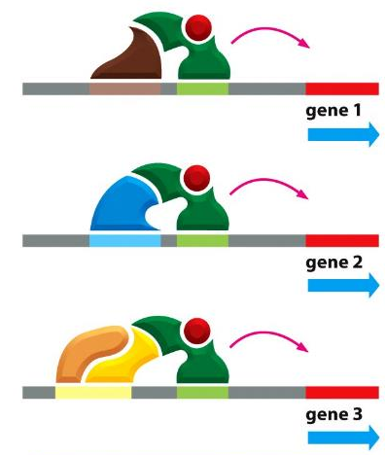
In Yeast, ~250 Transcription Factors Regulate ~6000 Genes through Combinatorial Control
Alberts et al. (2014)
Notes:
Anu
- Just define comb control and how those transcriion factors work together

Slide 6
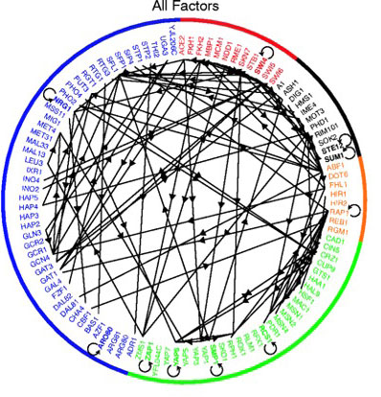
In Yeast, ~250 Transcription Factors Regulate ~6000 Genes through Combinatorial Control
Gene Regulatory Network (GRN)
of 106 Transcription Factors
Alberts et al. (2014)
Lee et al. (2002)
Notes:
anu

Slide 7
GRNsight is Optimized to Visualize Small- to Medium-Scale Networks
Cytoscape and Gephi | GRNsight
Optimized for large-scale graphs. | Optimized for small- to medium- scale graphs.
Must be installed. | Exists as a web application.
Several complex features in addition to visualization. | Easy to use, and easily interpretable visualizations.
Notes:
Anu
Side by side comparison point by point
Programs such as Cytoscape and Gephi visualize gene regulatory networks, but are optimized for large-scale graphs.
These programs need to be installed onto computers.
Both programs are complex and have several features in addition to visualization.
GRNsight is user friendly, exists as a web application, and lays out network graphs for medium-scale GRNs that are easily interpretable.

Slide 8
Outline
Gene regulatory networks (GRNs) consist of genes, transcription factors, and the regulatory relationships between them.
GRNsight is an open source web application and service for visualizing models of gene regulatory networks.
Version 1.0 established a testing framework and created an errors and warnings library.
Version 2.0 is in active development, available in beta website, and will allow for greater customization of the graph visuals.
Notes:
nicole

Slide 9
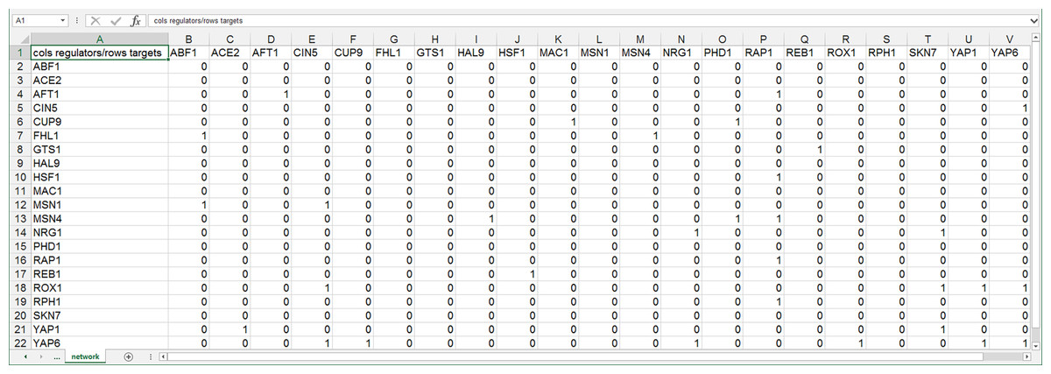
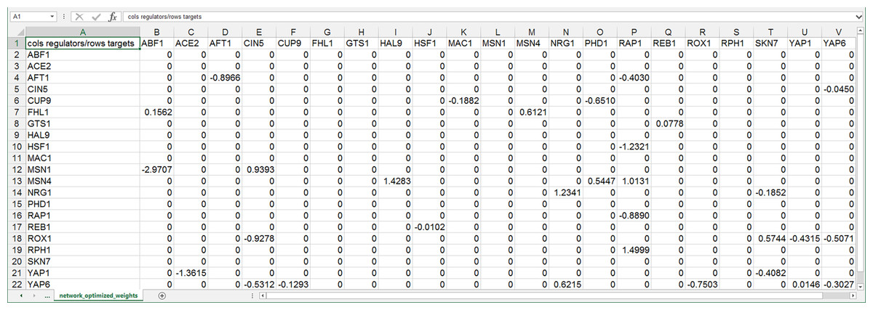
GRNsight Accepts Excel Spreadsheets with an Adjacency Matrix
Regulators and targets are in columns and rows respectively
Unweighted networks have 1’s and 0’s, weighted networks have real numbers instead of 1’s
Positive numbers indicate activation and negative numbers indicate repression
unweighted
weighted
Dahlquist et al. (2016) PeerJ Computer Science
Notes:
nicole
All are directed, but only some are weighted.

Slide 10
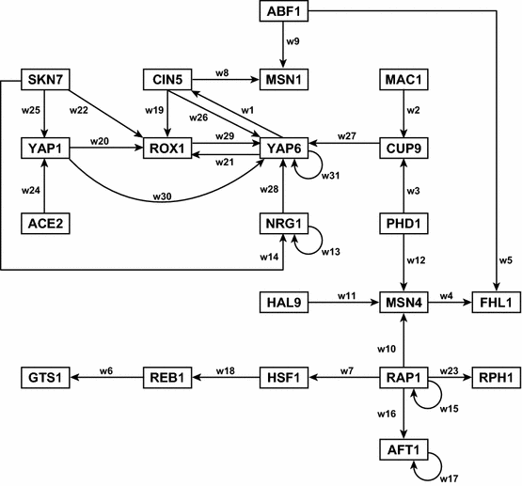
This GRN Diagram Took Several Hours to Create by Hand in Adobe Illustrator
Notes:
Recopy image

Slide 11
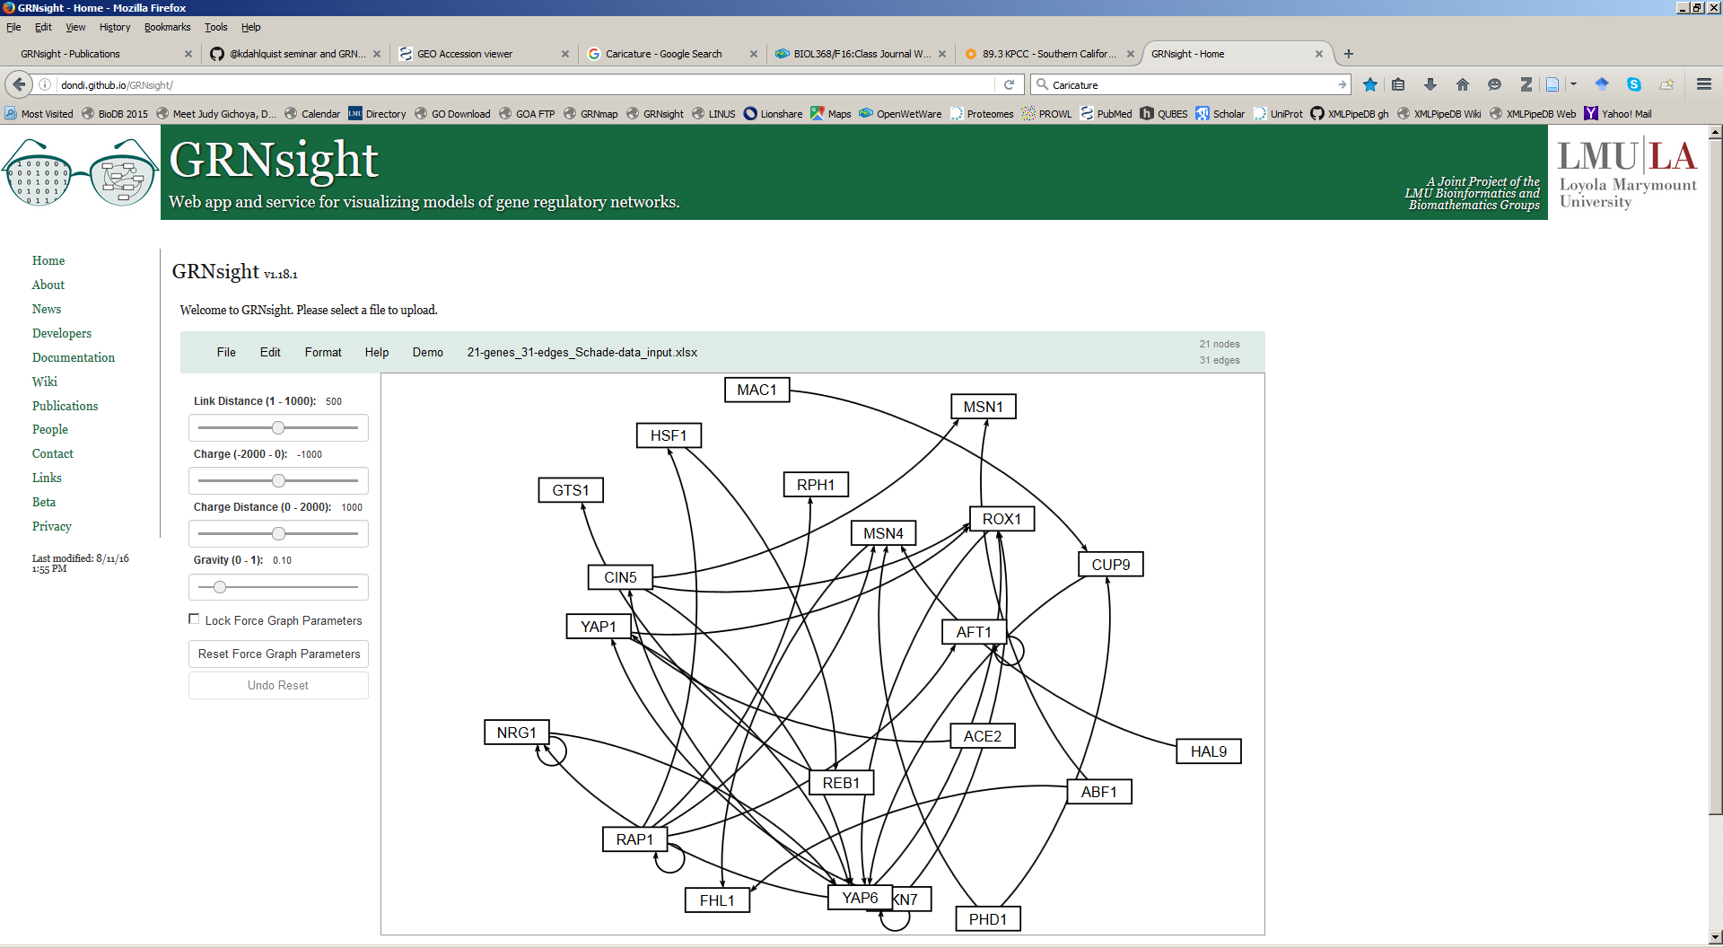
GRNsight Rapidly Generates GRN Graphs Using Our Customizations to the Open Source D3 Library
10 milliseconds to generate
Dahlquist et al. (2016) PeerJ Computer Science
Notes:
nicole

Slide 12
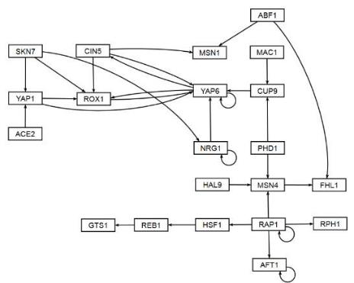
Users Can Rearrange Networks Using Drag and Drop
10 milliseconds to generate, 5 minutes to arrange
Dahlquist et al. (2016) PeerJ Computer Science
Notes:
Nicole
Title users can rearragne

Slide 13
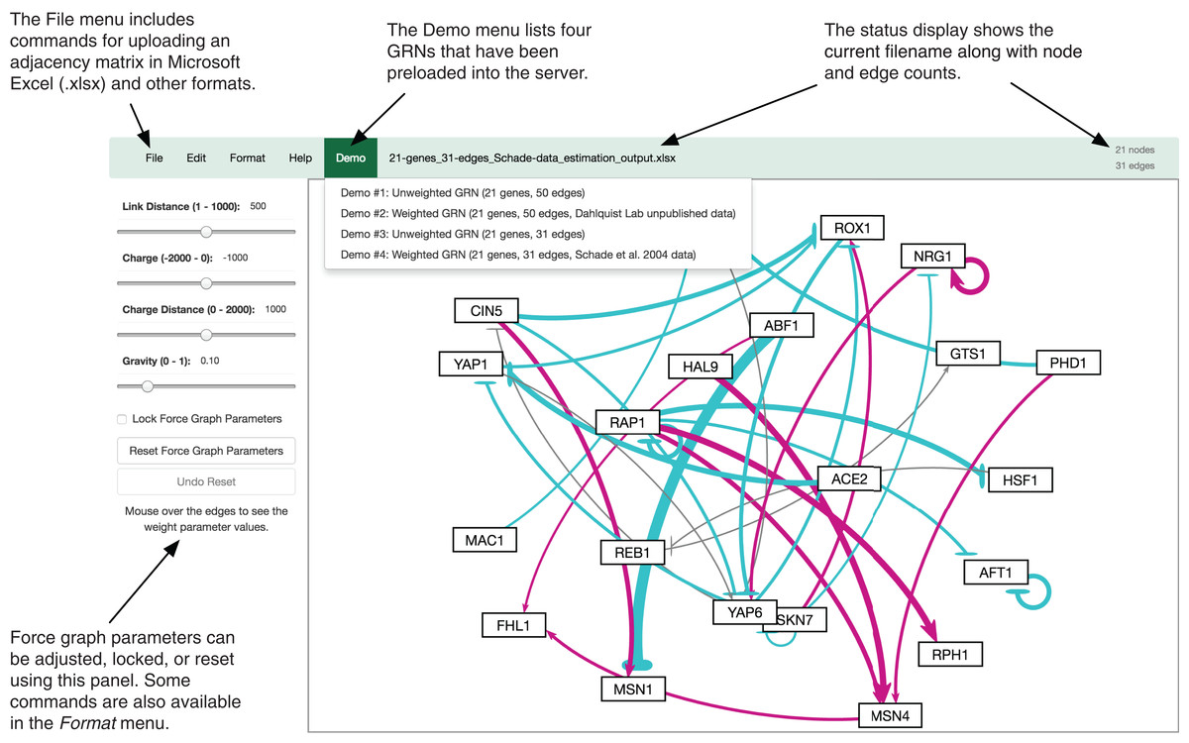
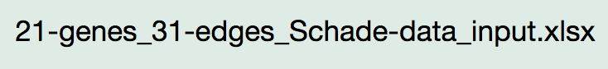
GRNsight Automatically Lays Out Weighted and Unweighted Networks
Dahlquist et al. (2016) PeerJ Computer Science
Notes:
Nicole
Make this a black and white graph and add another slide that has a weighted graph with explanations about colors and weights

Slide 14
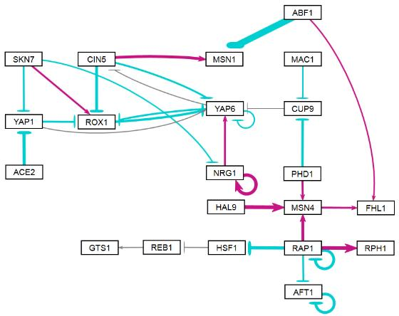
GRNsight Automatically Lays Out Weighted and Unweighted Networks
activation
repression
weak influence
GRNsight: colored and variable thickness edges reveal patterns in data

Slide 15
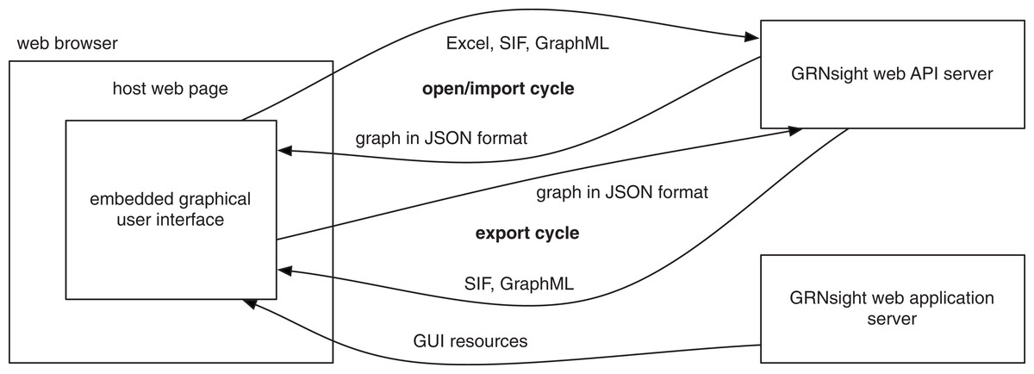
GRNsight Has a Service-Oriented Architecture
Dahlquist et al. (2016) PeerJ Computer Science
Notes:
Nicole
Focus on import

Slide 16
Outline
Gene regulatory networks (GRNs) consist of genes, transcription factors, and the regulatory relationships between them.
GRNsight is an open source web application and service for visualizing models of gene regulatory networks.
Version 1.0 established a testing framework and created an errors and warnings library.
Version 2.0 is in active development, available in beta website, and will allow for greater customization of the graph visuals.
Notes:
anu

Slide 17
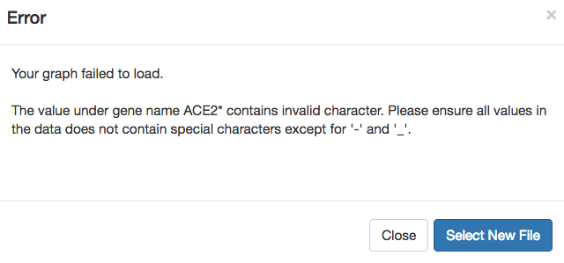
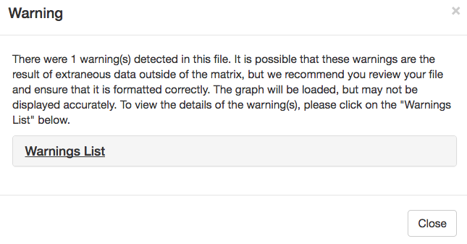
The Errors and Warnings Library Was Established In v1.0
When a user uploads a spreadsheet that is formatted incorrectly – GRNsight returns an error or a warning
Fatal = graph fails to load
Non-fatal = graph will load
Warning box can be closed and reopened at any time via a hyperlink underneath Force Graph Parameter sliders
Notes:
anu

Slide 18
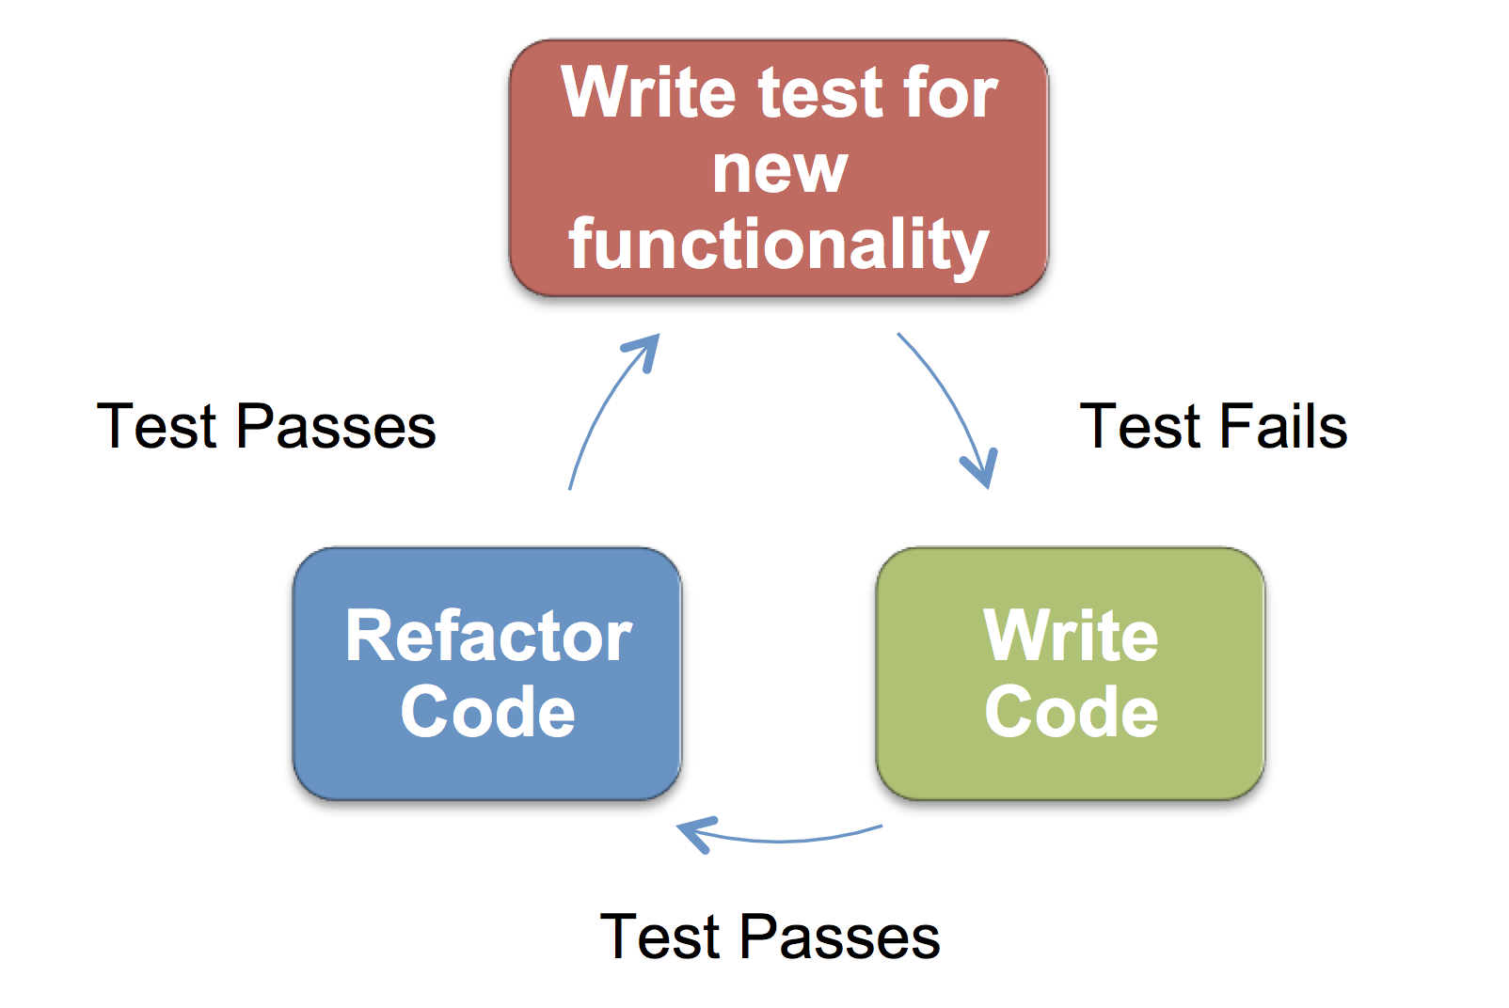
Test Driven Development (TDD) Ensures GRNsight Works as Expected
Consists of 230 passing tests covering over 500 test files in beta
Executed through Mocha, a JavaScript test framework running on node.js and written in Chai, an assertion library for node.js
Aspect of the code | Test coverage on v1.18.1 (%) | Test coverage on v2.0.1 (%)
Statements | 272/371 (73%) | 344/489 (71%)
Branches | 158/185 (85%) | 169/203 (83%)
Functions | 49/72 (68%) | 61/96 (63%)
Lines | 272/371 (73%) | 344/480 (71%)
Notes:
Replace decimals with %

Slide 19
Outline
Gene regulatory networks (GRNs) consist of genes, transcription factors, and the regulatory relationships between them.
GRNsight is an open source web application and service for visualizing models of gene regulatory networks.
Version 1.0 established a testing framework and created an errors and warnings library.
Version 2.0 is in active development, available in beta website, and will allow for greater customization of the graph visuals.
Notes:
anu

Slide 20
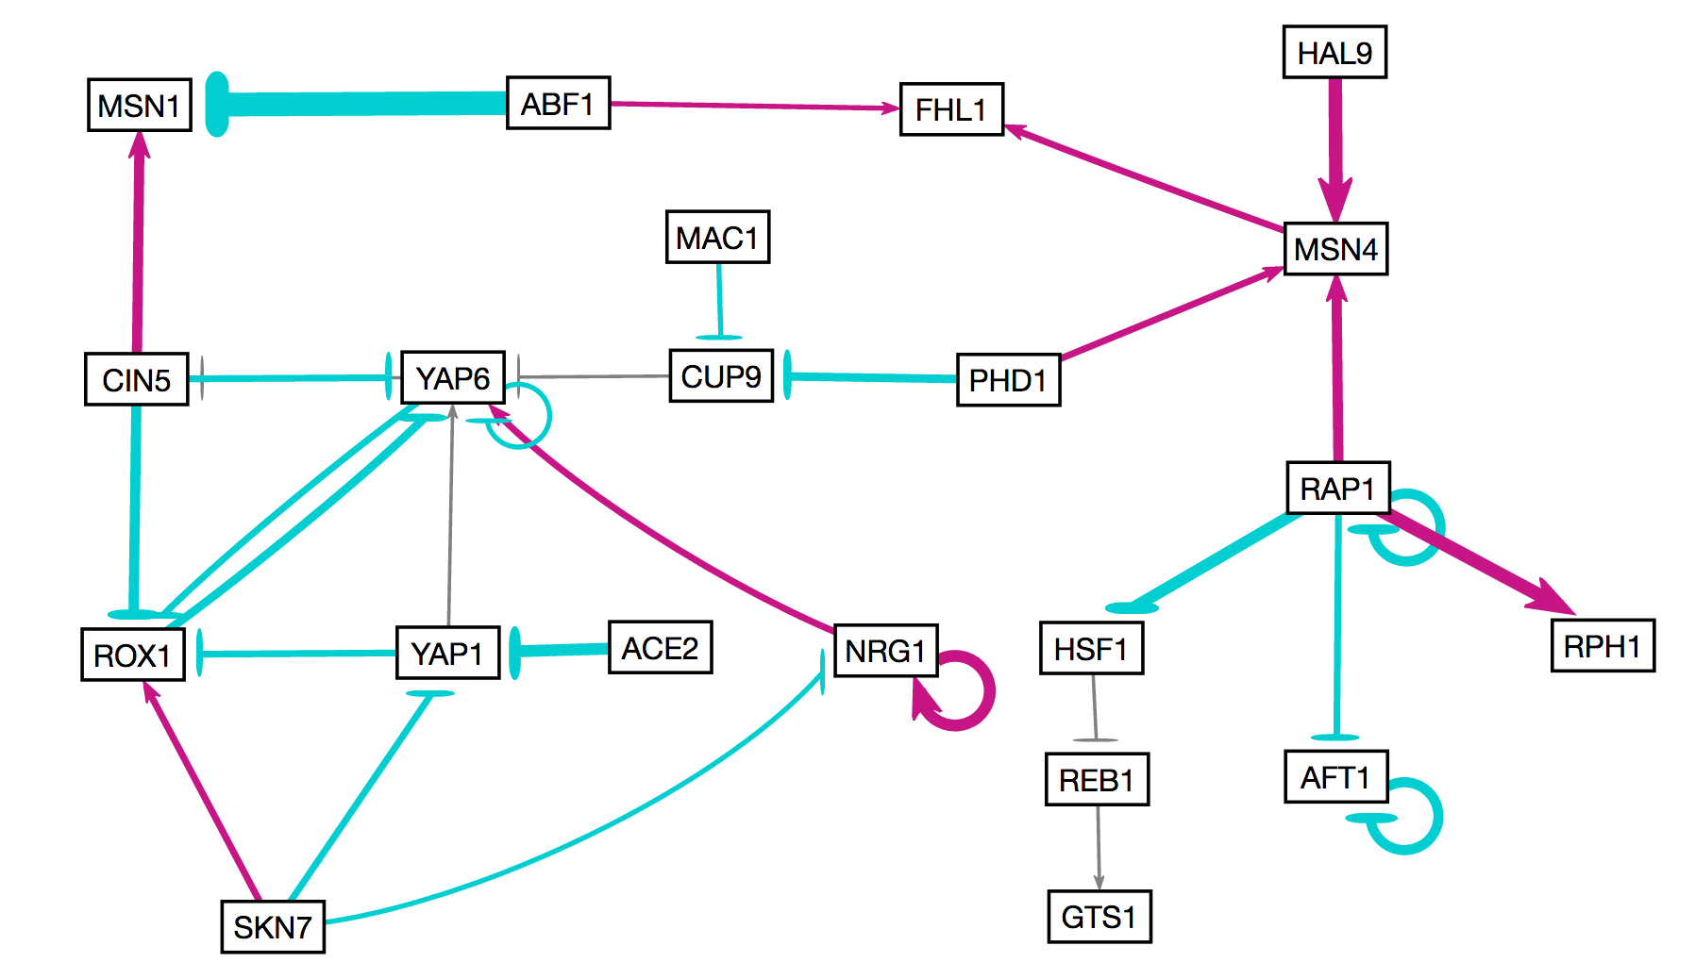
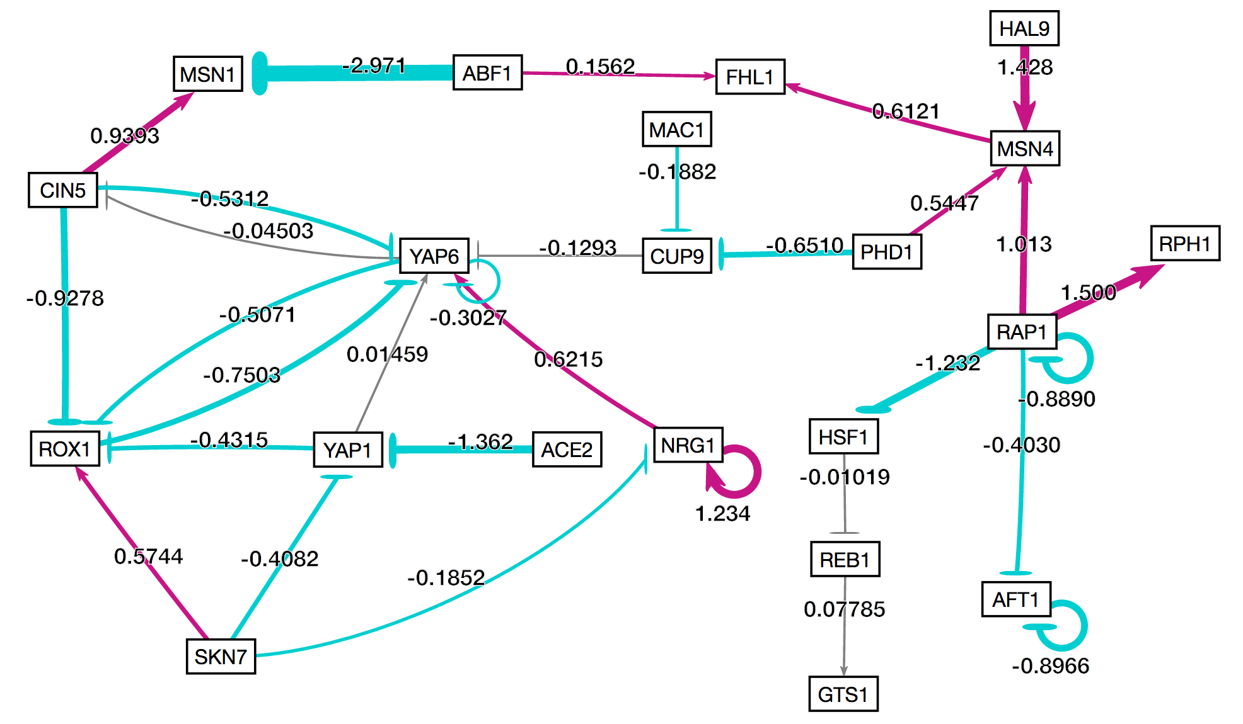
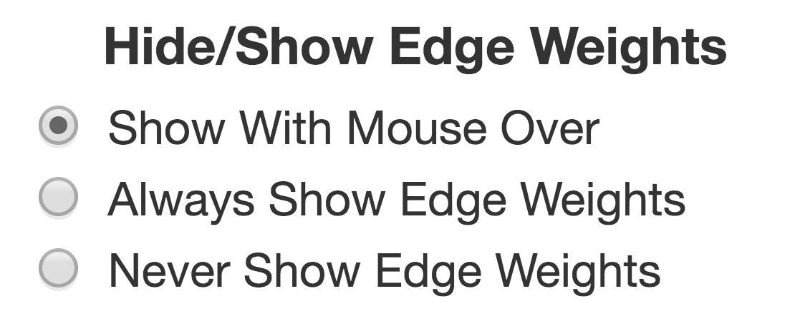
Visualization of Edge Weights is User Customizable
By default, weights are shown only upon mouse-over of the edge.
Users can choose to always show or always hide weights.
Option exists in sidebar menu, and under Format tab in the File menu.
Notes:
anu

Slide 21
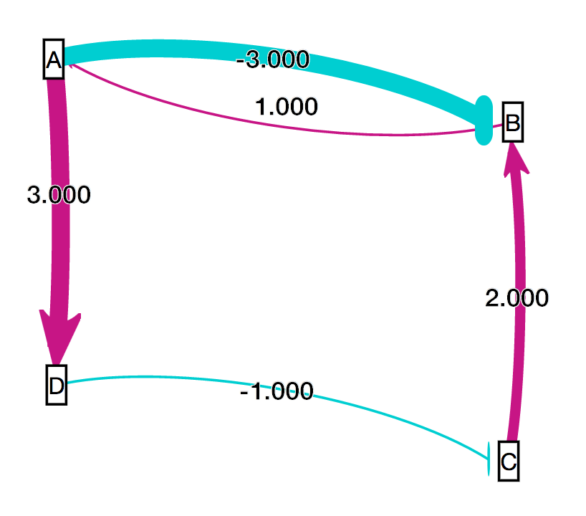
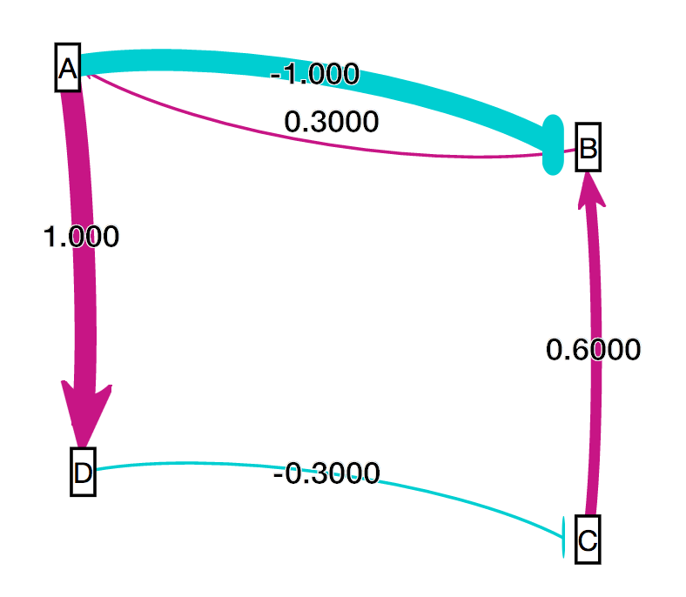
A Customizable Normalization Factor Allows Users to Compare Graphs
Relationship data is normalized to fit within 12 distinct edge thicknesses
Data from each graph is normalized according to matrix data
In order to compare graph visualizations, normalization factor must be the same
User inputs smallest value and largest value in all comparable matrices, and edge thicknesses adjust accordingly
vs.
Notes:
Anu
Add a graphic with a graph with one set of weights and another graphic with another set of weights and show the weights and show how they are not the same

Slide 22
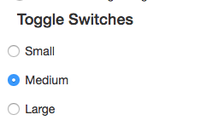
The viewport was enlarged to allow for easier visualization on different screen sizes
Three different viewport (visible area) sizes were added to adjust for different screen sizes.
Small is best for 13-15” laptops
Medium is best for 24” screens
Large is best for 32”+ screens
The initial size of the viewport is chosen automatically based on the amount of available space on the user’s screen.
It can also be changed via toggle switch.
Notes:
Nicole
-

Slide 23
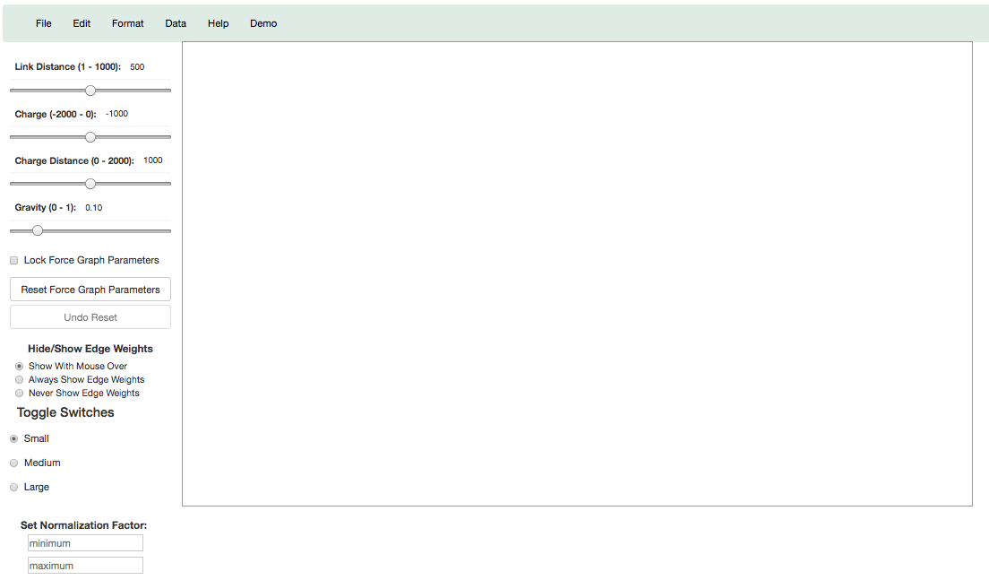
Viewport automatically detected as small on small screen
Notes:
Nicole
Viewport in red
Small laptop, auto chose small as best

Slide 24
The Drafting Board Was Enlarged for Optimal Graph Loading
The drafting board (drawable area) was initially too small to allow for the graph to fully expand to an optimal layout.
Larger viewport sizings allow for the graph to fully expand on load.
An automatic drafting board resizing algorithm is in development to allow graphs of all sizes to come to an optimal layout.
The drafting board will expand past the size of the viewport, and can be fully seen with zooming and scrolling.
The option of a hard (fixed to viewport) or adaptive (dynamic resizing) drafting board can be selected.
Notes:
Nicole
- Optimal layout = when graph relaxes complete without pushing against the boundaries of the viewport

Slide 25
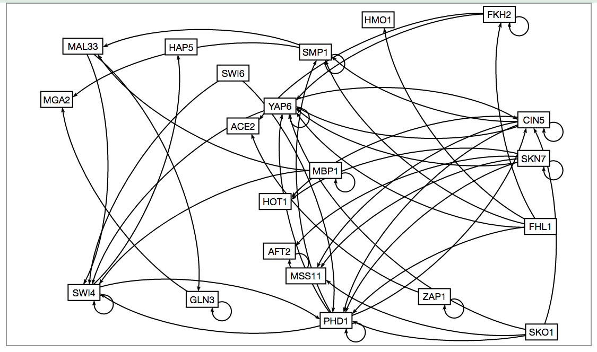
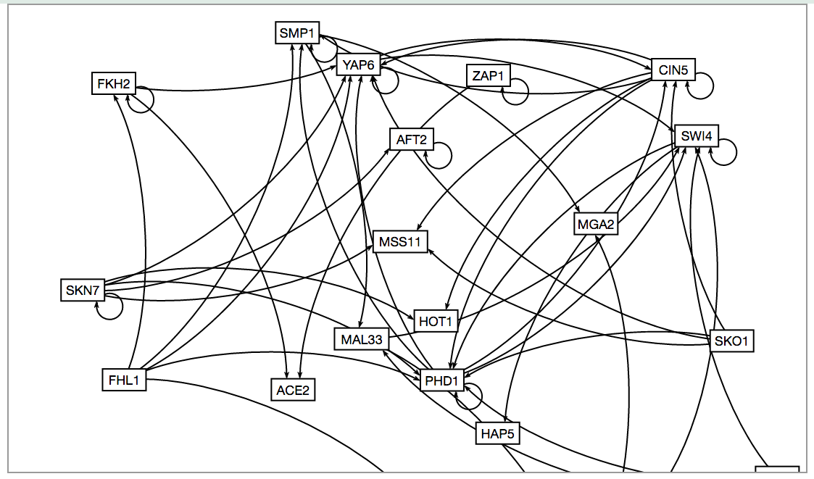
Adaptive drafting board algorithm extends drafting board beyond viewport
Zooming and Scrolling Enabled
Notes:
Nicole
- Zooming and scrolling enabled note on screen

Slide 26
Summary
Gene regulatory networks (GRNs) consist of genes, transcription factors, and the regulatory relationships between them.
GRNsight is an open source web application and service for visualizing models of gene regulatory networks.
Version 1.0 established a testing framework and created an errors and warnings library.
Version 2.0 is in active development, available in beta website, and will allow for greater customization of the graph visuals.
Notes:
Anu
Sub notes about specific features

Slide 27


Acknowledgments
Loyola Marymount University
Dr. Kam D. Dahlquist
Dr. John David N. Dionisio
Dr. Ben G. Fitzpatrick
GRNsight Team
Nicole Anguiano
Mihir Samdarshi
Jen Shin
Eileen Choe
Edward Bachoura
GRNmap Team
Trixie Anne Roque
Eddie Azinge
Natalie Williams
Kristen Horstmann
Maggie O’Neil
Brandon Klein
Justin Kyle Torres
Wet Lab Team
Monica Hong
Nika Vafadari
Katherine Scheker
http://dondi.github.io/GRNsight/
Notes:
Nicole
Show github icons and then click and show the picture, add all of our urls on the top of the page

